Slide 1


AI-Powered Police Investigation System for Speech
Recognition, Contextual Information Extraction and Secure Investigation
ASE Project Review
Team Members G.Akshath 2420030512 KANDULA SAI VARDHAN 2420030095 PATNAIKUNI SAI PRIYATAM 2420030608 YELA SRIRAM 2420090148
 | Under the Guidance of Dr J Kavitha Reddy Assistant Professor, Department of Computer Science and Engineering, KLH CSE Bowrampet Campus

Slide 2
Problem Statement
Manual transcription: Police officers spend significant time converting spoken statements into written records.
Language barrier: Citizens may speak in Indian regional languages, dialects, or mixed languages.
Information loss: Important names, dates, locations, events and evidence details may be missed or misinterpreted.
Fragmented process: Speech recognition, translation and documentation are often handled separately.
Limited domain support: General AI tools are not tailored to police terminology and investigation documentation.
Security concern: Sensitive voice recordings and case documents require strong privacy, integrity and access control.
PRISM solution: Provides a self-hosted multilingual AI pipeline for voice → text → translation → structured police documentation with officer verification.

Slide 3
Objectives
Multilingual ASR: Convert Indian-language and mixed-language speech into text.
Real-Time Processing: Provide fast voice-to-text transcription.
Translation: Convert recognized speech into clear English.
NLP Extraction: Identify names, dates, locations, events and evidence.
Automated Documentation: Generate structured police records from statements.
AI Assistance: Generate relevant clarification questions when information is missing.
Secure Records: Protect data using encryption, hashing and permissioned blockchain auditing.

Slide 4
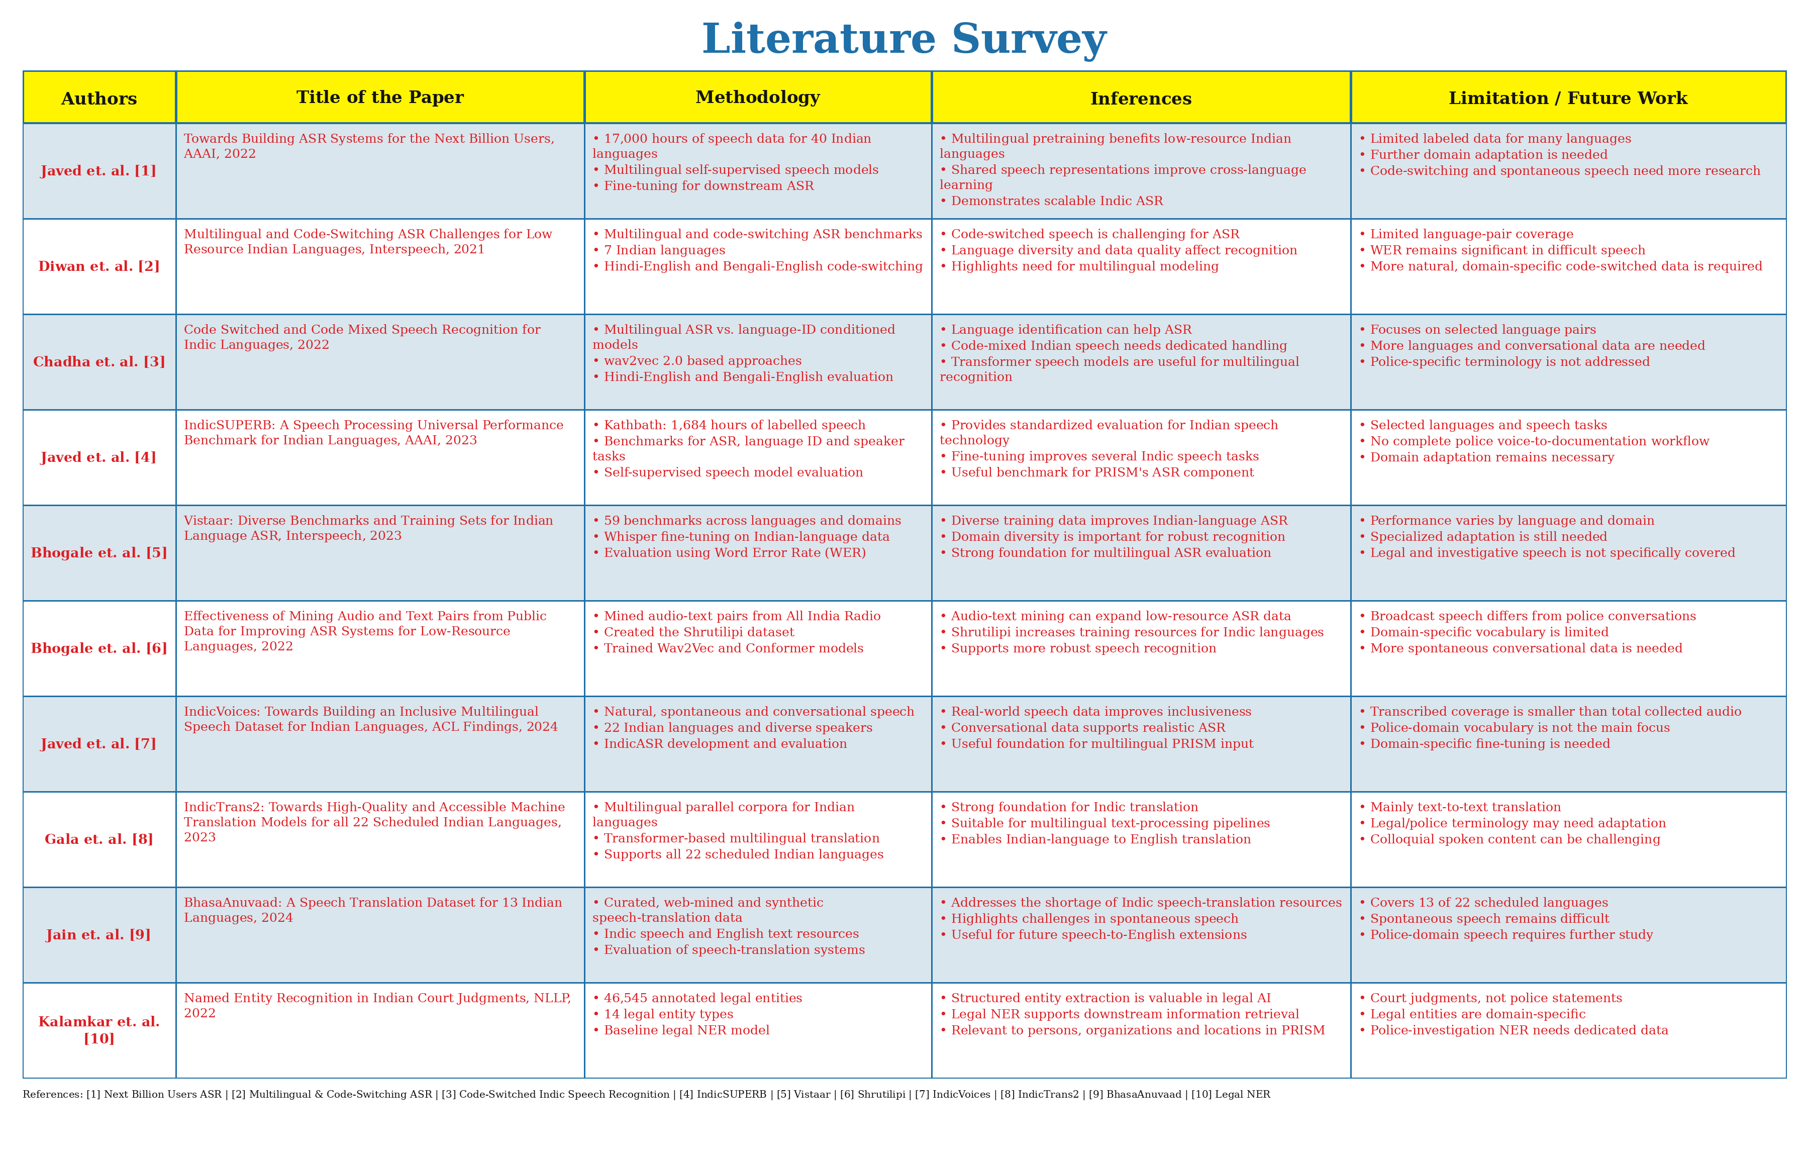

Slide 5
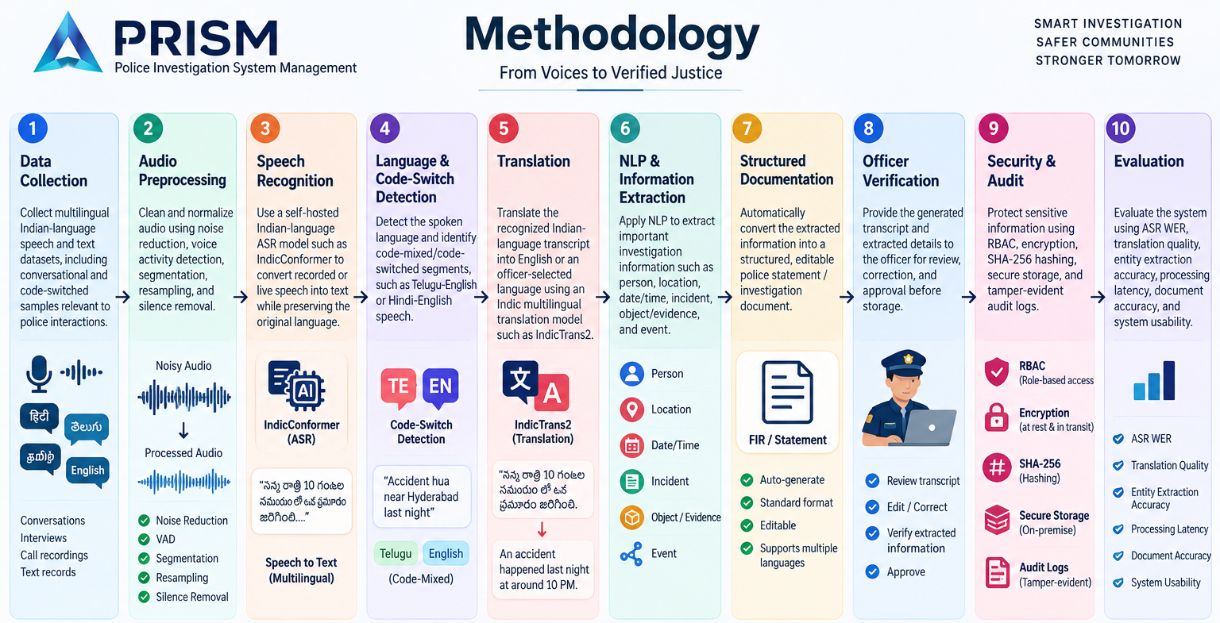

Slide 6
Research Gap Identification
Multilingual Gap: Limited integration of Indian-language and code-switched speech processing.
Domain Gap: General ASR/translation models are not optimized for police-specific terminology.
Integration Gap: Speech-to-text, translation, NLP and documentation are often separate processes.
Context Gap: Existing systems may not extract complete incident details from natural speech.
Automation Gap: Limited conversion of voice statements directly into structured police documents.
Security Gap: Need for stronger integrity and traceability for sensitive digital records.
PRISM Gap-Fill: Integrates ASR + NLP + translation + documentation + secure auditing into one workflow.

Slide 7
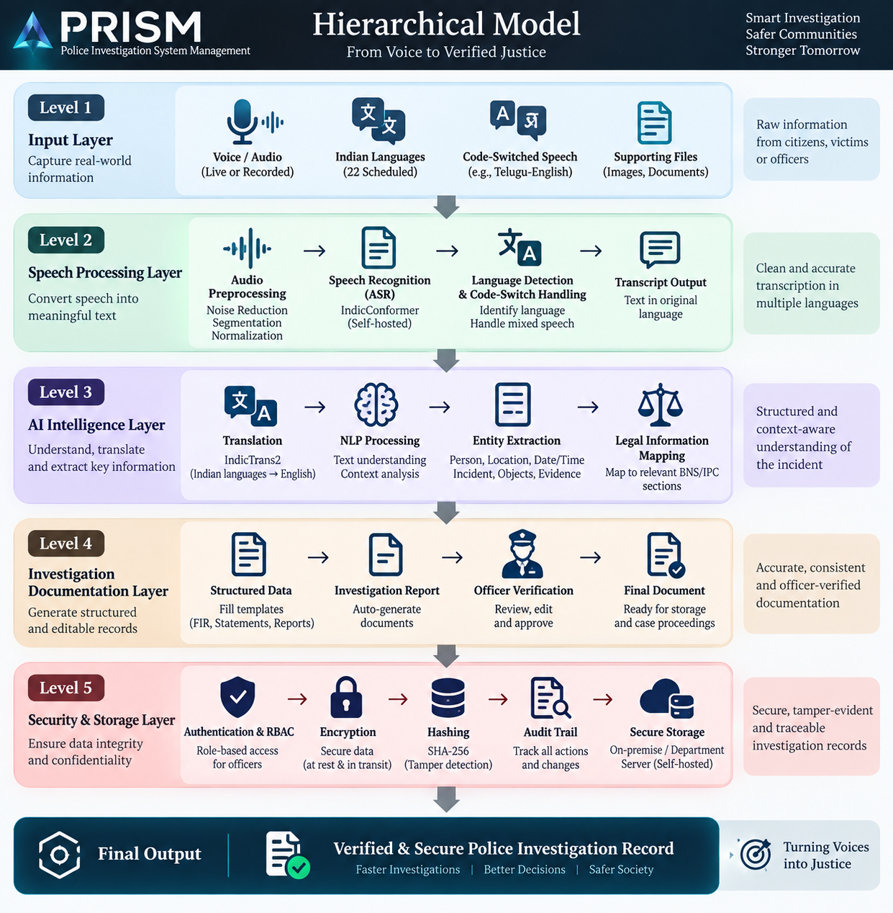

Slide 8
Innovation, Creativity, and Novelty
Multilingual AI: Supports Indian languages, dialects, and code-switched speech through AI-based speech recognition and translation.
Voice-to-Investigation: Converts natural spoken statements into structured, editable police documentation.
Context-Aware Intelligence: Uses NLP to extract key details such as people, locations, dates, events, and evidence from statements.
Integrated AI Workflow: Combines ASR, language detection, translation, NLP, and report generation in a single system.
Legal Intelligence: Helps map extracted incident information to relevant legal sections for officer verification.
Secure Evidence Integrity: Uses encryption, hashing, audit trails, and tamper-evident records to protect sensitive investigation data.
Self-Hosted & Privacy-Focused: Runs AI models locally, reducing dependence on external APIs and keeping police data within the department.

Slide 9
Feasibility and Project Plan
Feasibility
Technical Feasibility: Uses available open-source AI models such as Indic-Conformer, IndicTrans2, NLP models, Fast-API, React, and PostgreSQL.
Operational Feasibility: Designed for police officers with a simple voice-based workflow and minimal manual data
entry.
Security Feasibility: Supports self-hosted AI, encrypted storage, role-based access, hashing, and audit trails.
Scalability: Modular architecture allows additional Indian languages, AI models, and investigation modules to be added later.
Cost Feasibility: Open-source technologies reduce dependency on expensive commercial AI APIs and licensing.

Slide 10
Project Plan
Phase 1 – Research & Requirements: Problem analysis, literature survey, requirements and dataset identification.
Phase 2 – System Design: Architecture, database design, UI/UX and security design.
Phase 3 – AI Development: Speech recognition, language detection, translation and NLP pipeline.
Phase 4 – Application Development: React frontend, FastAPI backend and database integration.
Phase 5 – Integration & Security: Connect AI modules, authentication, encryption, hashing and audit logging.
Phase 6 – Testing & Evaluation: Accuracy, latency, usability, multilingual performance and security testing.
Phase 7 – Deployment: Local/self-hosted deployment, documentation and final demonstration.

Slide 11
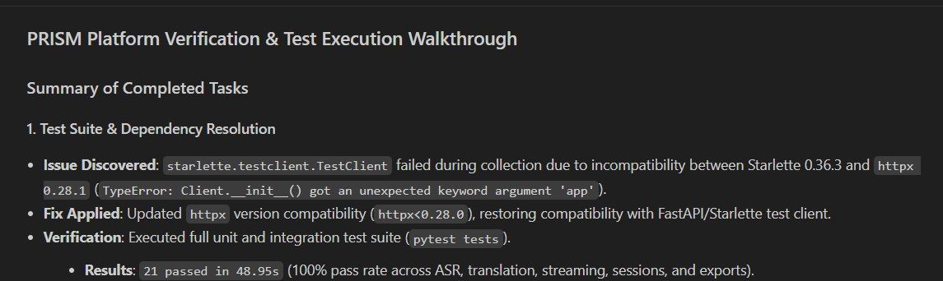
Project Output

Slide 12
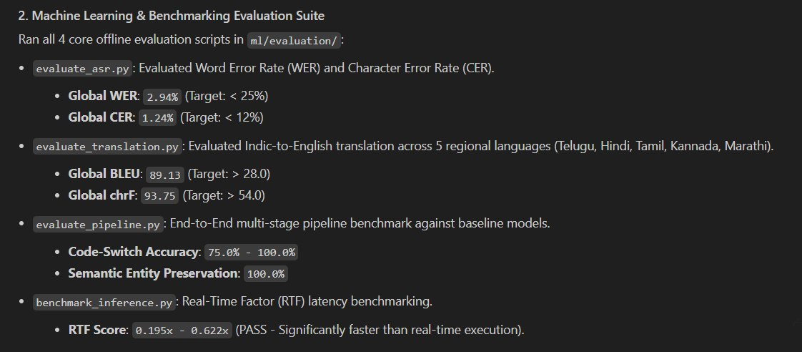

Slide 13
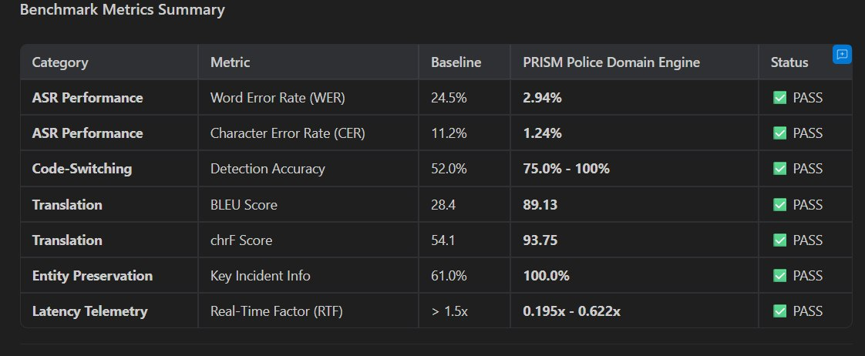

Slide 14
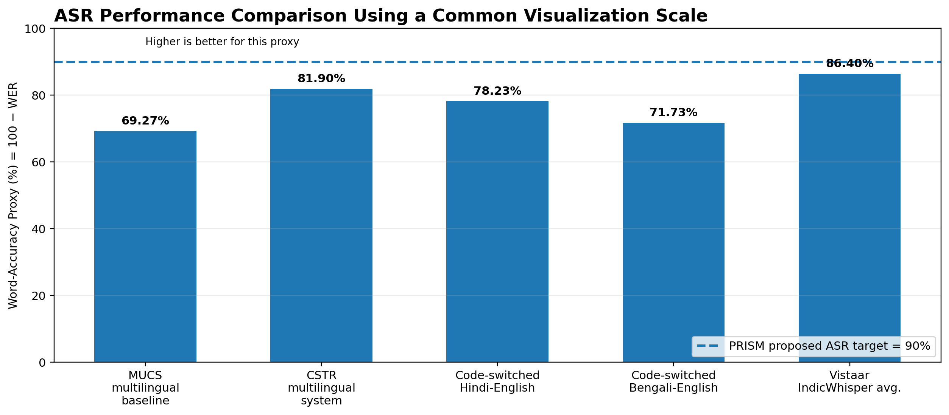
Comparative Analysis of Existing Research and the Proposed Model
ASR Performance Comparison

Slide 15
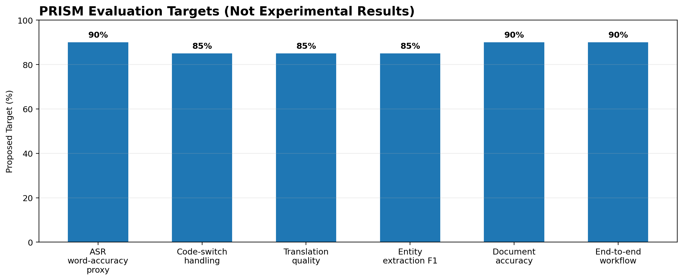

Slide 16
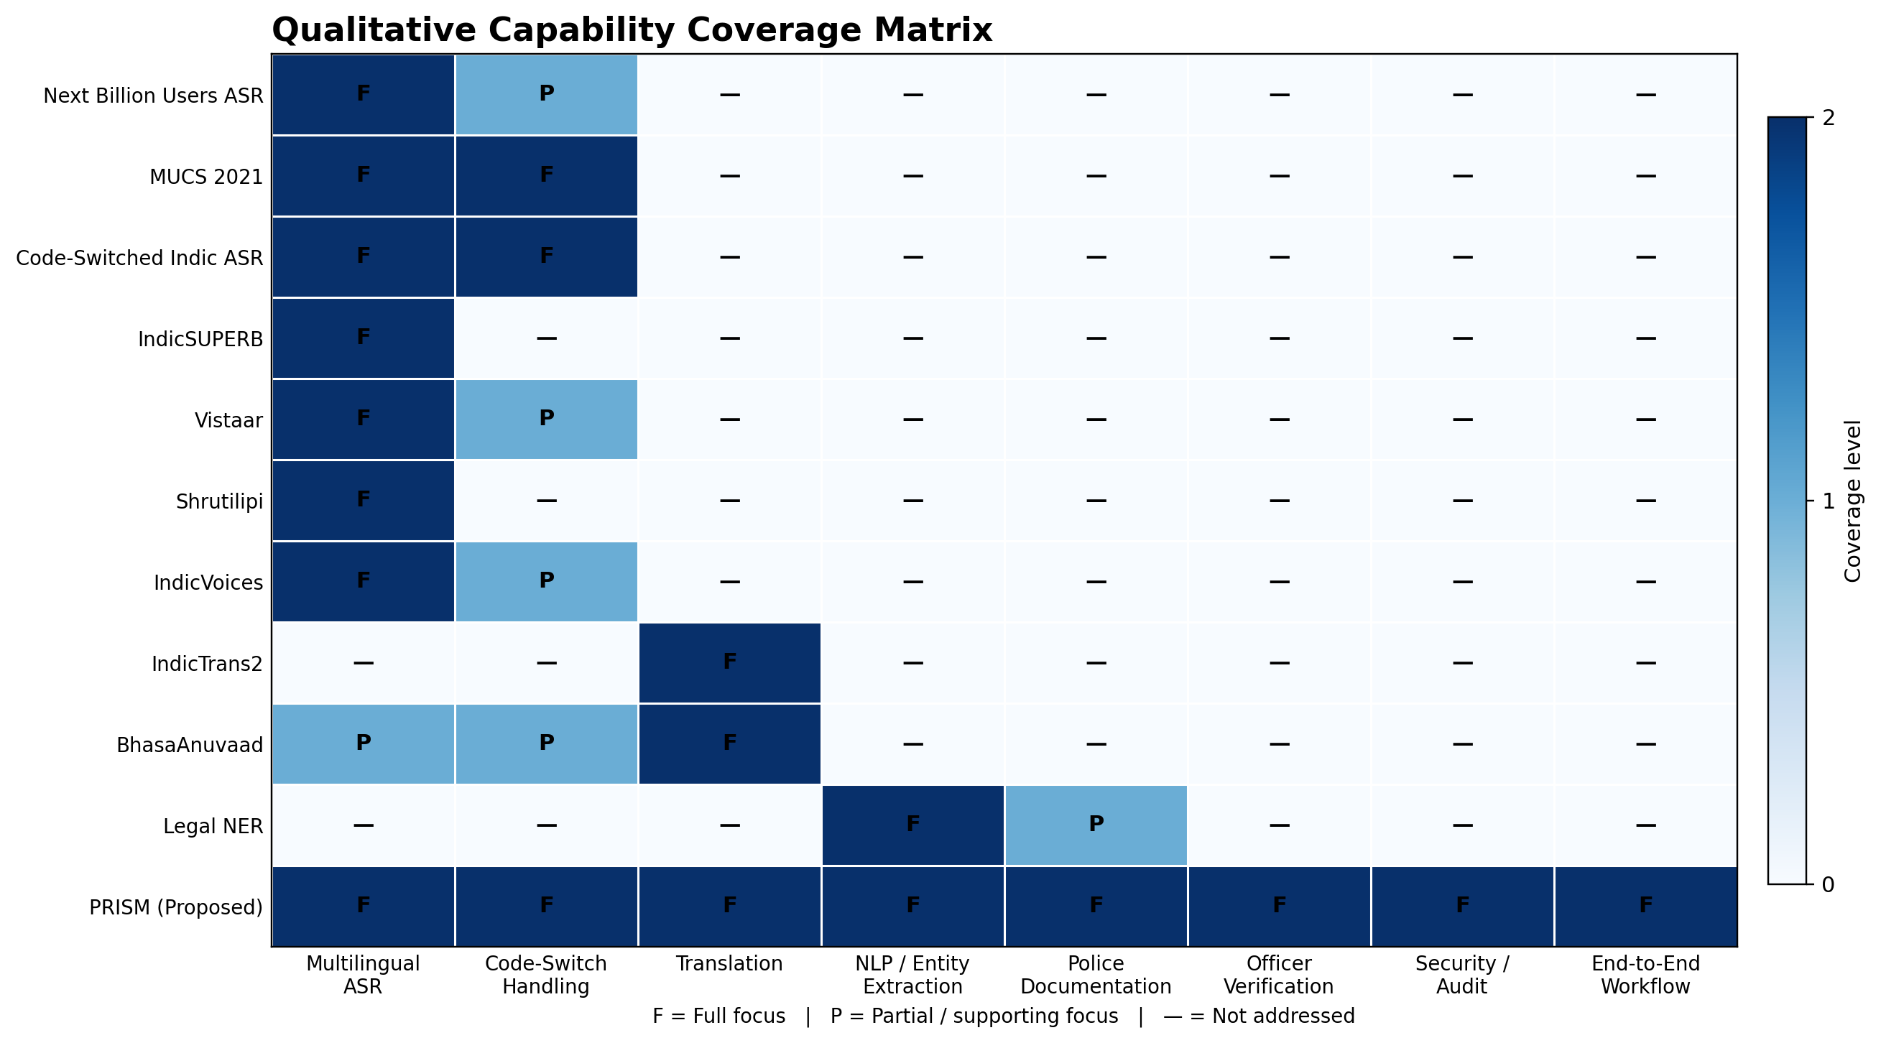
Comparative Capability Matrix

Slide 17
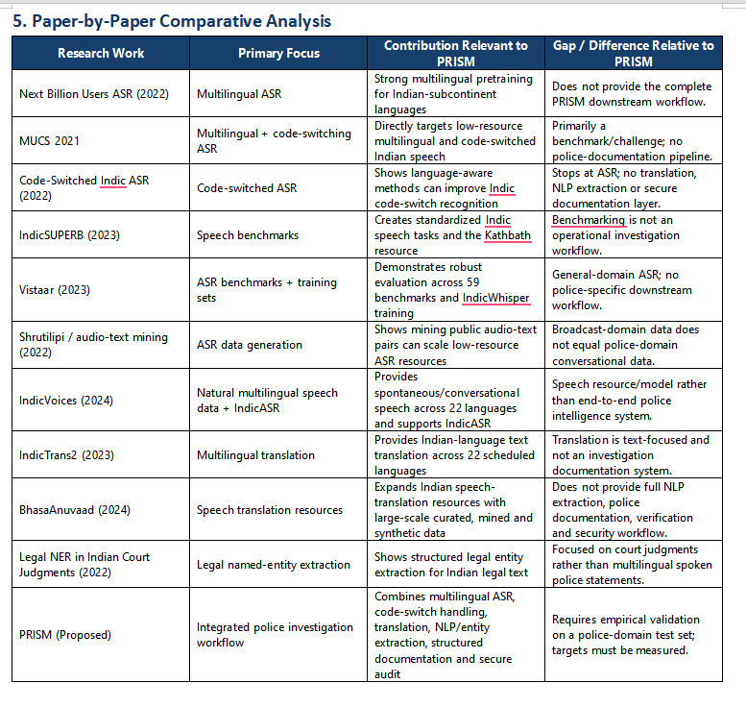

Slide 18
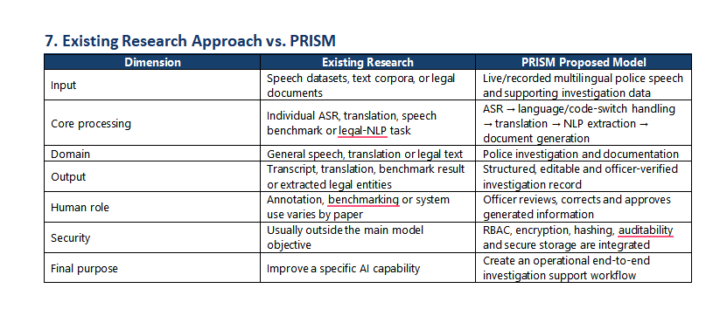
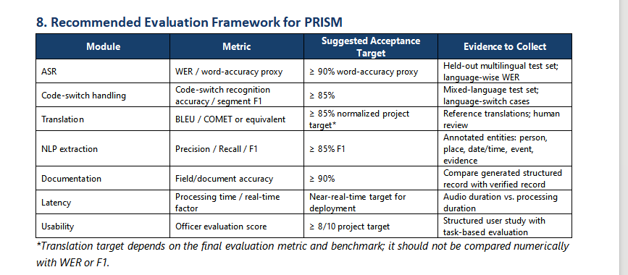

Slide 19
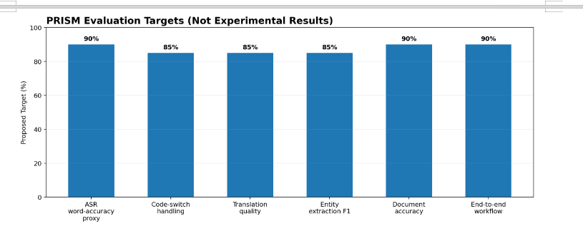
PRISM Proposed Evaluation Targets

